Slide 1

NAME: More. Keerthana
ORGANIZATION: Micro IT
TOPIC: Student Management System

Slide 2
INTRODUCTION
A Student Management System is a software application designed to efficiently manage and organize student-related information such as names, roll numbers, marks, and more. In educational institutions, handling student records manually can be time consuming, error-prone, and inefficient.
This project, developed using C++, aims to automate these tasks through a menu-driven console interface. It provides basic functionalities such as adding new students, displaying student details, searching for a student by roll number, updating existing records, and deleting students from the system. It also includes file handling to store data permanently.

Slide 3
Objectives
To develop a simple and efficient system for managing student records.
To implement core C++ concepts such as structures, functions, and file handling.
To perform basic operations: add, view, search, update, and delete student data.
To store and retrieve student information using file I/O.

Slide 4
What is a Student Management System?
A Student Management System (SMS) is a software application designed to manage and store all student-related information in an organized way. It allows educational institutions to handle academic records efficiently, including student details like:
Name, roll number, class, and contact information
Academic performance and marks
Attendance records
Administrative tasks (e.g., updating or deleting records)

Slide 5
TYPES OF STUDENT MANAGEMENT SYSTEMS:
Basic SIS: Manages student records and attendance.
Comprehensive SIS: Adds grades, exams, and course management.
LMS with SMS: Focuses on online learning and student progress.
Cloud-Based SMS: Online access, easy collaboration.
On-Premises SMS: Installed locally, more control.

Slide 6
RISKS AND RETURNS
✅ Returns:
Saves time and reduces manual errors
Easy access to student data
Improves communication (alerts, reports)
Long-term cost savings
Provides useful analytics
⚠️ Risks:
Data security and privacy issues
High initial setup cost
System downtime or failure
Resistance from users
Ongoing maintenance needs

Slide 7
Construction of Student Management System
Requirement Analysis – Define features: view, search, delete, update students.
Structure Design – Create struct Student with rollNo, name, age, course.
Data Initialization – Preload student data in an array.
Function Development – Write functions for display, search, delete, and update.
Menu Interface – Implement menu using do-while and switch.
Testing – Validate each function with inputs.
Extension (optional) – Add features like add, file storage, sorting.

Slide 8

Key Learnings from the internship
Gained practical programming and debugging experience
Understood software development life cycle (SDLC)
Improved teamwork and communication skills
Developed problem-solving and troubleshooting abilities
Learned to use industry tools like Git and databases
Practiced time management and professionalism

Slide 9
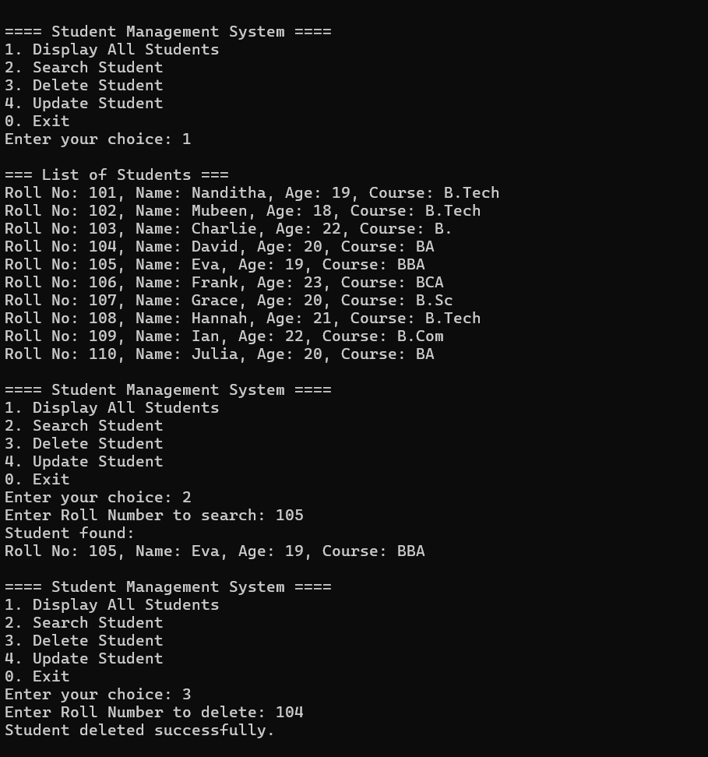

Slide 10
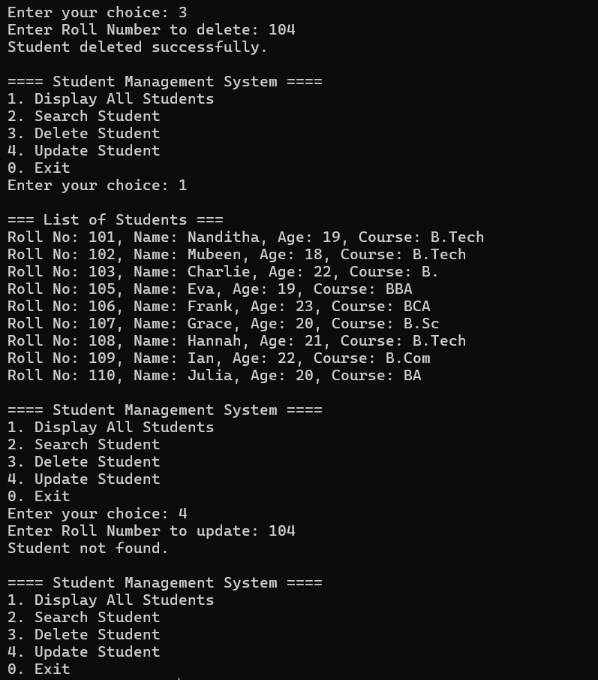

Slide 11
CONCLUSION:
This internship connected theoretical knowledge with real-world portfolio management practices. It enhanced my abilities in analysis, decision-making, and investment strategy planning.

Slide 12
….THANK YOU….

